Slide 1
An Overview of Parameterized Inapproximability
Xuandi Ren
Peking University
2021.12.12

Slide 2
Backgrounds
Assuming NP≠P, a lot of optimization problems do not admit polynomial time (exact) algorithms!
Parameterization & Approximation
two popular ways of coping with NP-hard problems

Slide 3
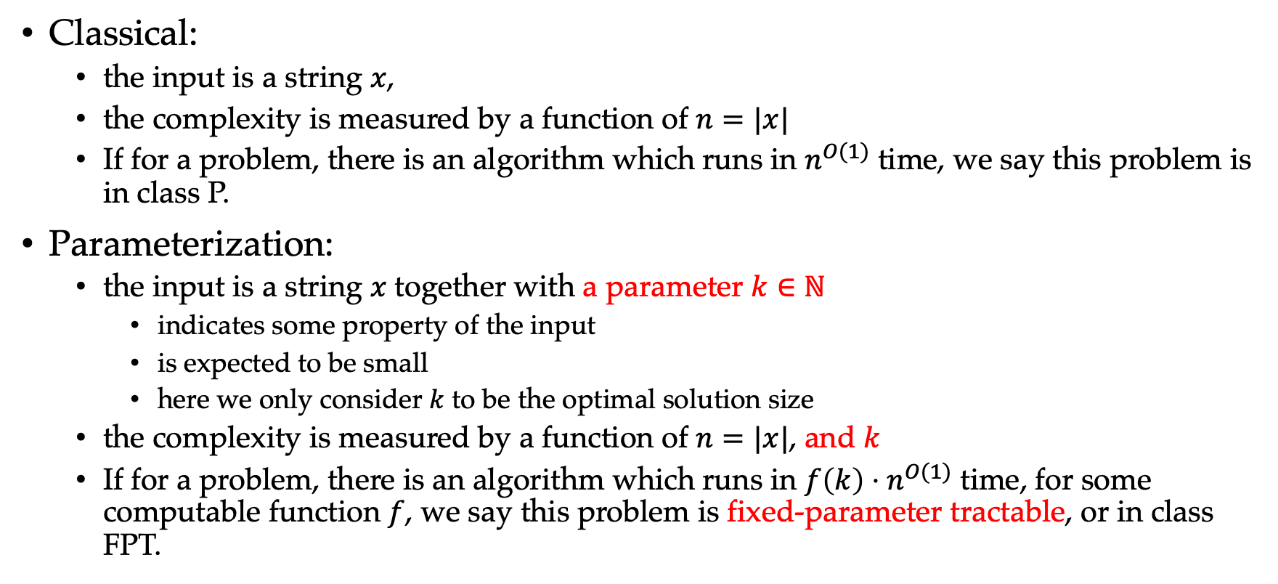
What is Parameterization?
Classical:
the input is a string $x$,
the complexity is measured by a function of $n=|x|$
If for a problem, there is an algorithm which runs in $n^{O(1)}$ time, we say this problem is in class P.
Parameterization:
the input is a string $x$ together with a parameter $k∈ℕ$
indicates some property of the input
is expected to be small
here we only consider $k$ to be the optimal solution size
the complexity is measured by a function of $n=|x|$, and $k$
If for a problem, there is an algorithm which runs in $f\left(k\right)⋅n^{O(1)}$ time, for some computable function $f$, we say this problem is fixed-parameter tractable, or in class FPT.

Slide 4
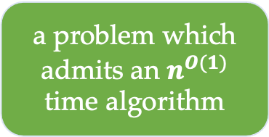
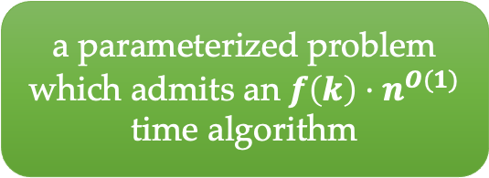
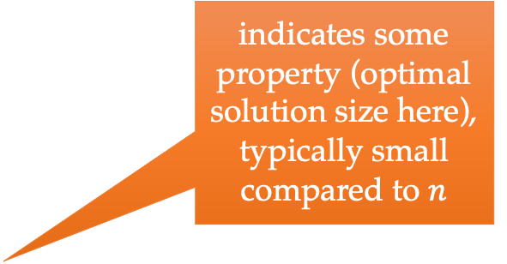
Parameterization
FPT
(fixed-parameter tractable)
P
indicates some property (optimal solution size here), typically small compared to $n$
a parameterized problem which admits an $f\left(k\right)⋅n^{O(1)}$ time algorithm
a problem which admits an $n^{O(1)}$ time algorithm

Slide 5
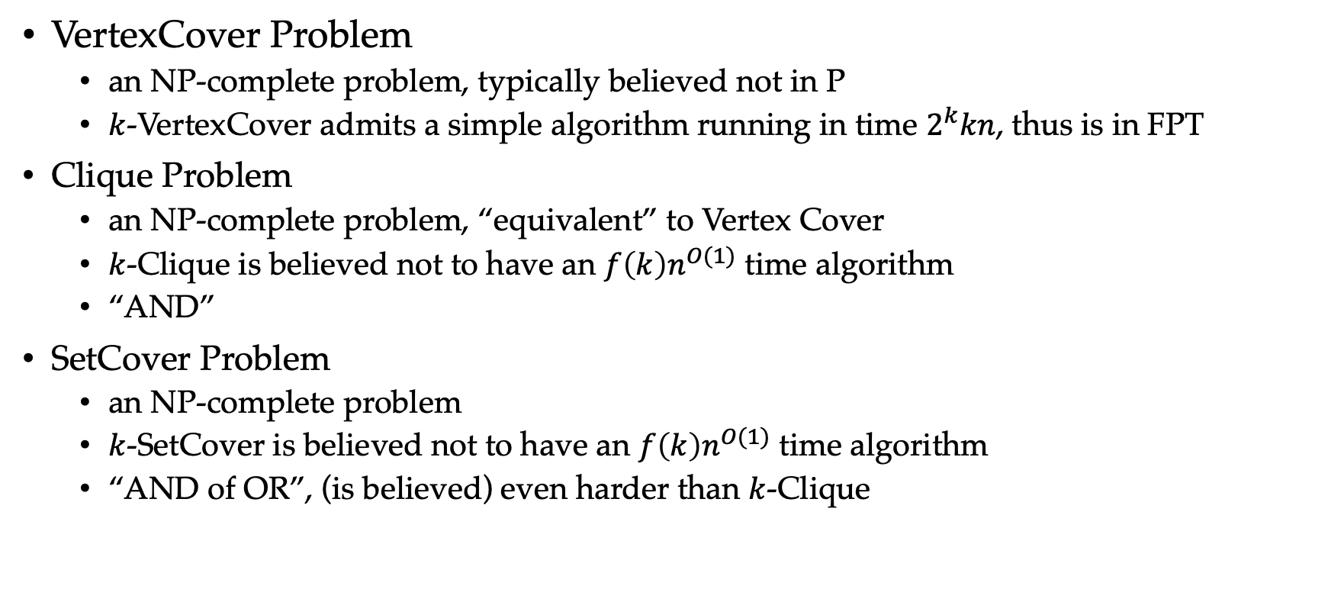
Parameterization: Examples
VertexCover Problem
an NP-complete problem, typically believed not in P
$k$-VertexCover admits a simple algorithm running in time $2^{k}kn$, thus is in FPT
Clique Problem
an NP-complete problem, “equivalent” to Vertex Cover
$k$-Clique is believed not to have an $f\left(k\right)n^{O(1)}$ time algorithm
“AND”
SetCover Problem
an NP-complete problem
$k$-SetCover is believed not to have an $f\left(k\right)n^{O(1)}$ time algorithm
“AND of OR”, (is believed) even harder than $k$-Clique

Slide 6

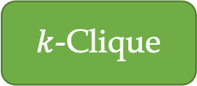
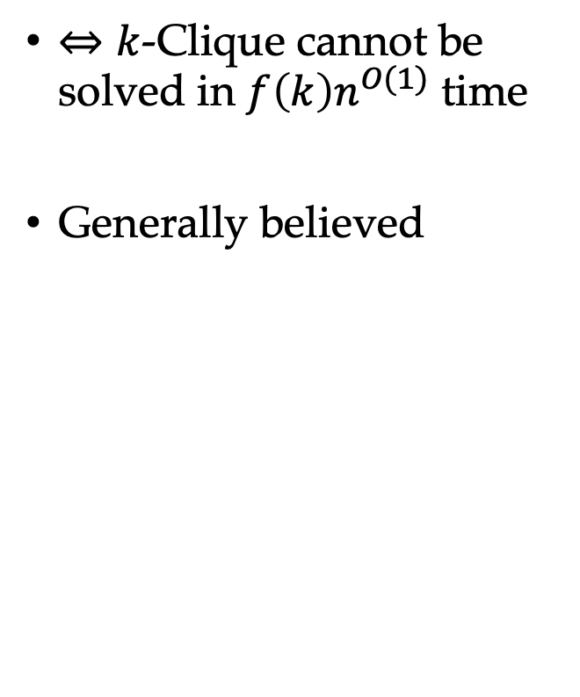
Hypothesis: W[1]≠FPT
$⇔k$-Clique cannot be solved in $f\left(k\right)n^{O(1)}$ time
Generally believed
W[2]
W[1]
FPT
P
$k$-Clique
$k$-SetCover

Slide 7
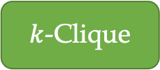
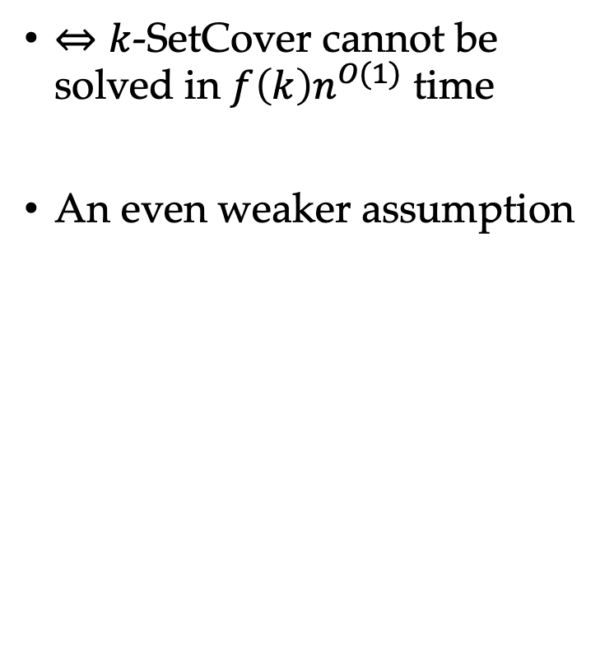

Hypothesis: W[2]≠FPT
$⇔k$-SetCover cannot be solved in $f\left(k\right)n^{O(1)}$ time
An even weaker assumption
W[2]
FPT
W[1]
P
$k$-SetCover
$k$-Clique

Slide 8

…
FPT
W[2]
W[1]
P
$k$-Clique
$k$-SetCover

Slide 9
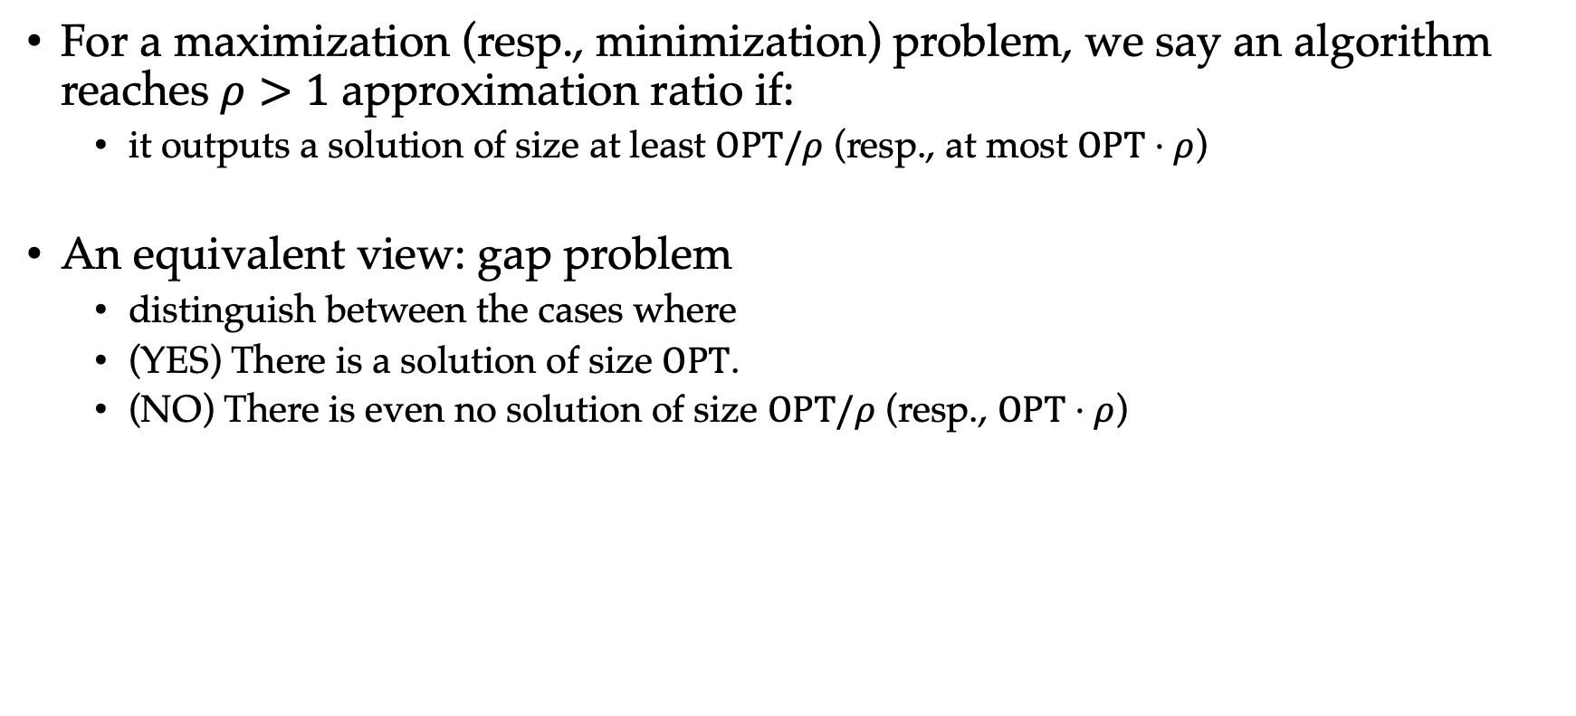
Approximation
For a maximization (resp., minimization) problem, we say an algorithm reaches $ρ>1$ approximation ratio if:
it outputs a solution of size at least $OPT/ρ$ (resp., at most $OPT⋅ρ$)
An equivalent view: gap problem
distinguish between the cases where
(YES) There is a solution of size $OPT$.
(NO) There is even no solution of size $OPT/ρ$ (resp., $OPT⋅ρ$)

Slide 10
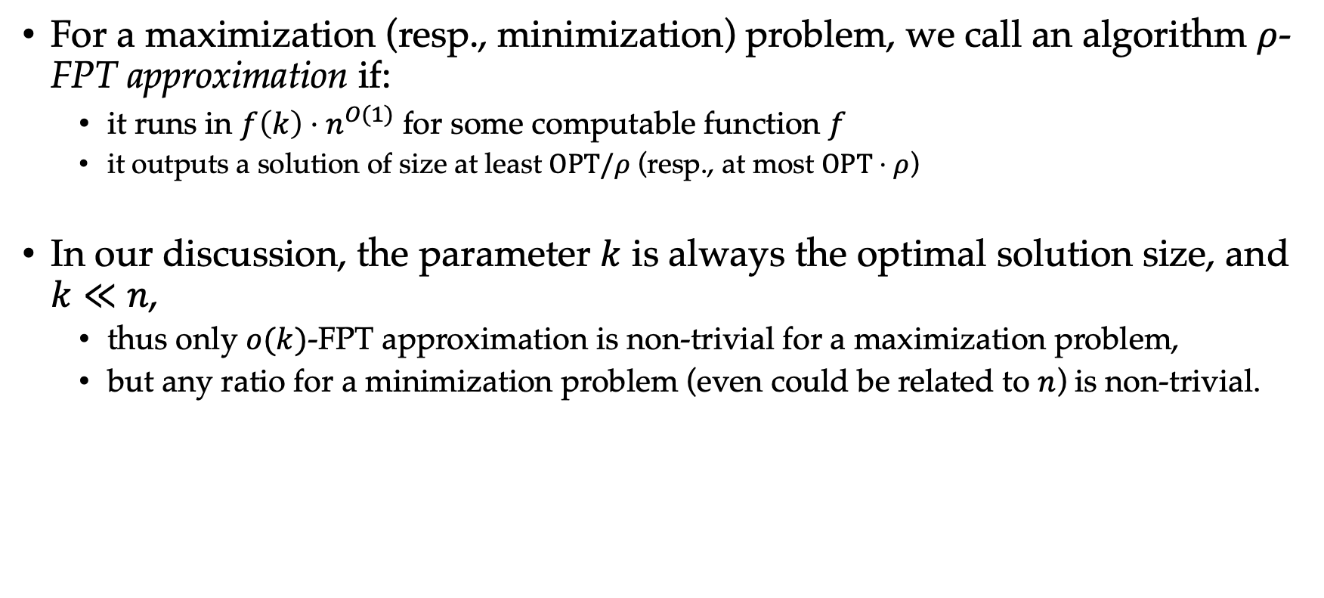
Parameterized Approximation
For a maximization (resp., minimization) problem, we call an algorithm $ρ$-FPT approximation if:
it runs in $f\left(k\right)⋅n^{O(1)}$ for some computable function $f$
it outputs a solution of size at least $OPT/ρ$ (resp., at most $OPT⋅ρ$)
In our discussion, the parameter $k$ is always the optimal solution size, and $k≪n$,
thus only $o(k)$-FPT approximation is non-trivial for a maximization problem,
but any ratio for a minimization problem (even could be related to $n$) is non-trivial.

Slide 11
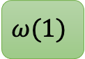

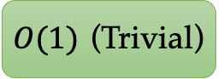
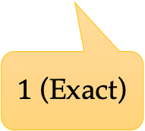
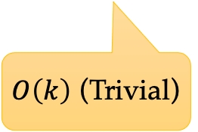
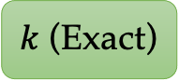
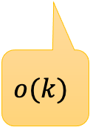
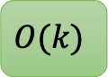
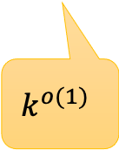
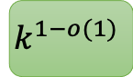
Parameterized Approximation
Maximization
Approximation Ratio/Solution Size (from bad to good, i.e., from easy to hard)
$O\left(k\right)$ (Trivial)
$$o(k)$$
$$k^{o(1)}$$
$$O(1)$$
$1$ (Exact)
$O(1)$ (Trivial)
$$ω(1)$$
$$k^{1−o(1)}$$
$$O(k)$$
$k$ (Exact)

Slide 12
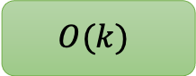
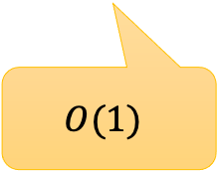

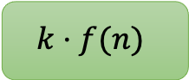
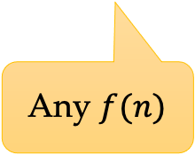
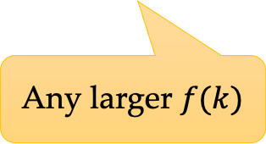
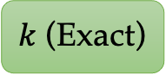
Parameterized Approximation
Minimization
Approximation Ratio/Solution Size (from bad to good, i.e., from easy to hard)
Any $f(n)$
Any larger $f(k)$
$$O(1)$$
$1$ (Exact)
$$k⋅f(n)$$
$$k⋅f(k)$$
$$O(k)$$
$k$ (Exact)

Slide 13
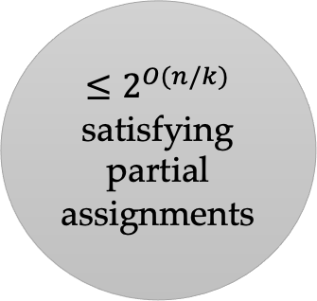
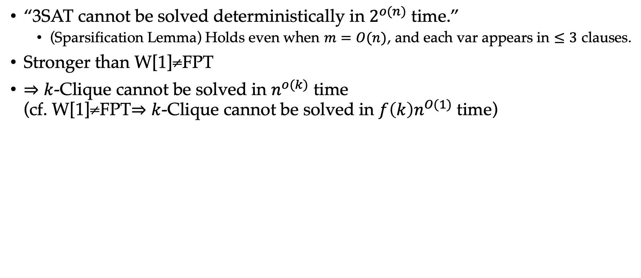
Hypothesis: ETH
“3SAT cannot be solved deterministically in $2^{o(n)}$ time.”
(Sparsification Lemma) Holds even when $m=O(n)$, and each var appears in $≤3$ clauses.
Stronger than W[1]≠FPT
$⇒k$-Clique cannot be solved in $n^{o(k)}$ time (cf. W[1]≠FPT$⇒k$-Clique cannot be solved in $f\left(k\right)n^{O(1)}$ time)
$≤2^{O(n/k)}$ satisfying partial assignments

Slide 14
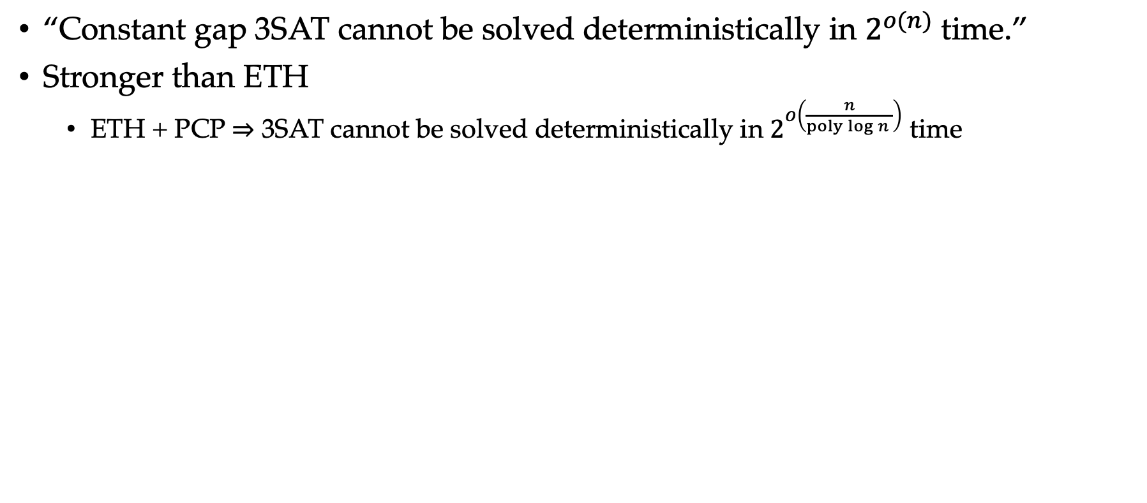
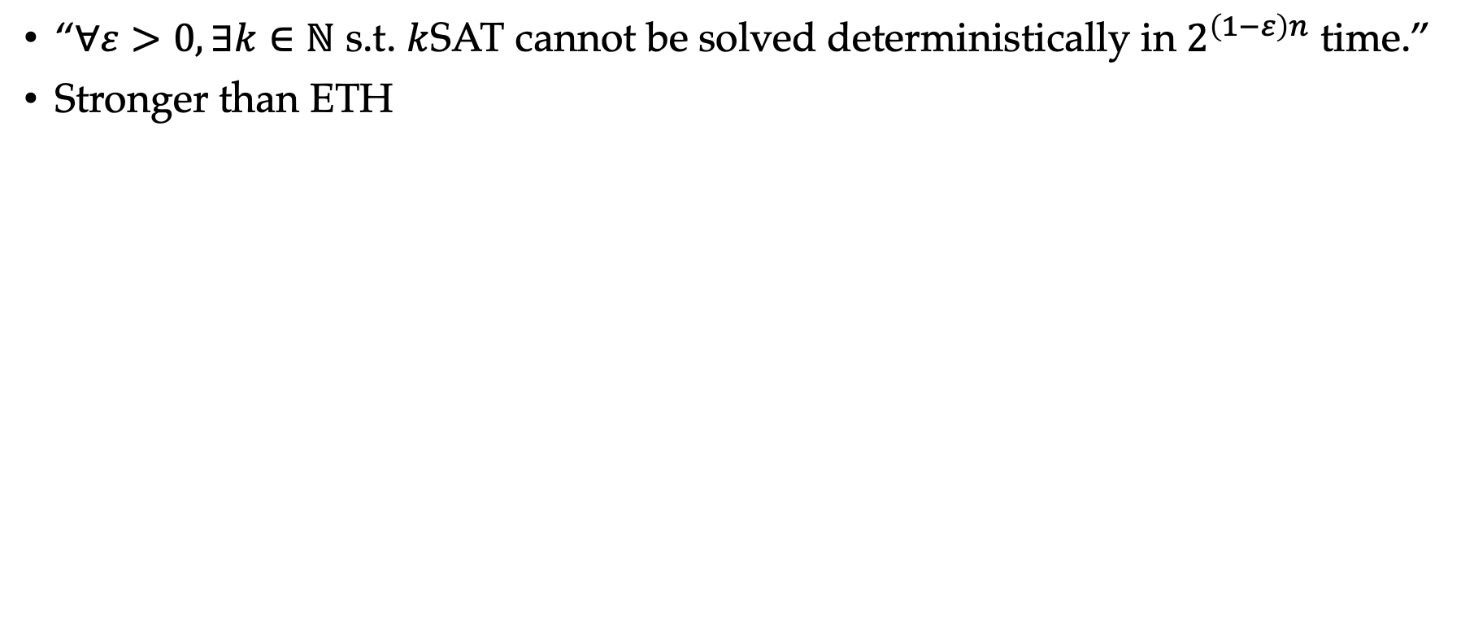
Hypothesis: Gap-ETH
“Constant gap 3SAT cannot be solved deterministically in $2^{o(n)}$ time.”
Stronger than ETH
ETH + PCP $⇒$ 3SAT cannot be solved deterministically in $2^{o\left(\frac{n}{poly\log{n} }\right)}$ time
Hypothesis: SETH
“$∀ε>0, ∃k∈ℕ$ s.t. $k$SAT cannot be solved deterministically in $2^{\left(1−ε\right)n}$ time.”
Stronger than ETH

Slide 15
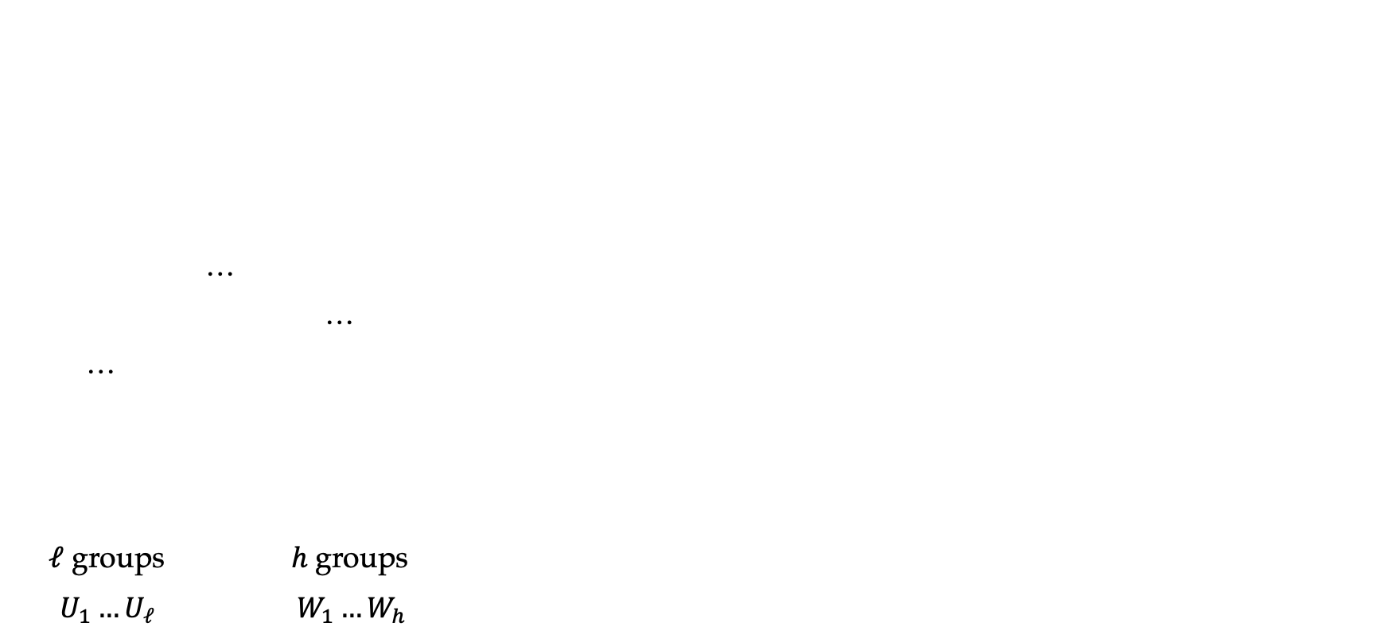
MaxCover & MinLabel
…
…
…
$ℓ$ groups $h$groups
$U_{1}…U_{ℓ}$ $W_{1}…W_{h}$
MaxCover =
MinLabel =

Slide 16
MaxCover & MinLabel: Results

Slide 17
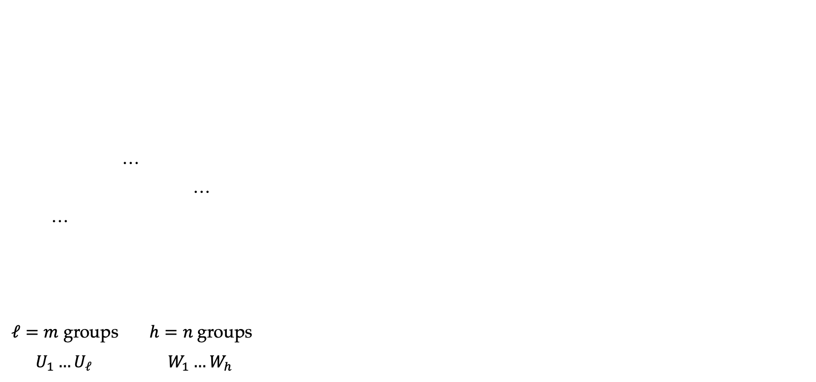
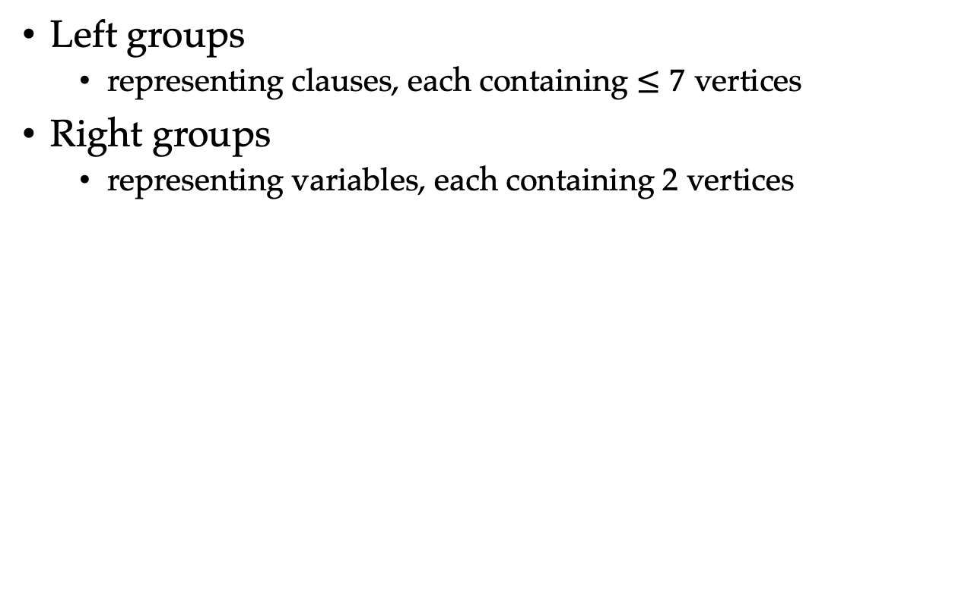
MaxCover & MinLabel: Starting from Gap-ETH
…
…
…
$ℓ=m$ groups $h=n$groups
$U_{1}…U_{ℓ}$ $W_{1}…W_{h}$
Left groups
representing clauses, each containing $≤7$ vertices
Right groups
representing variables, each containing 2 vertices

Slide 18
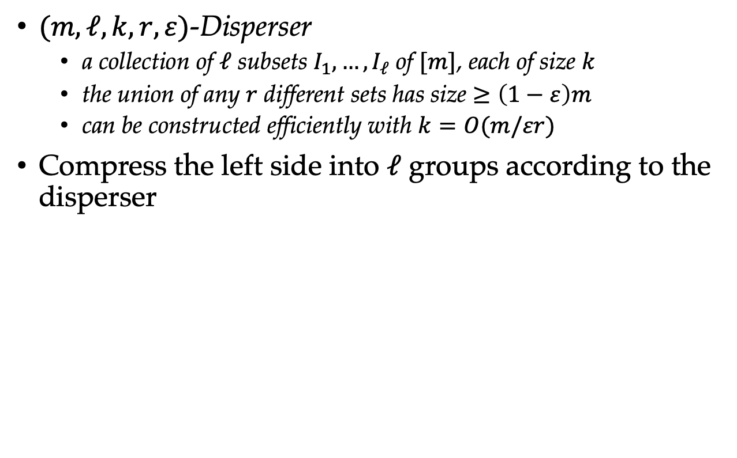
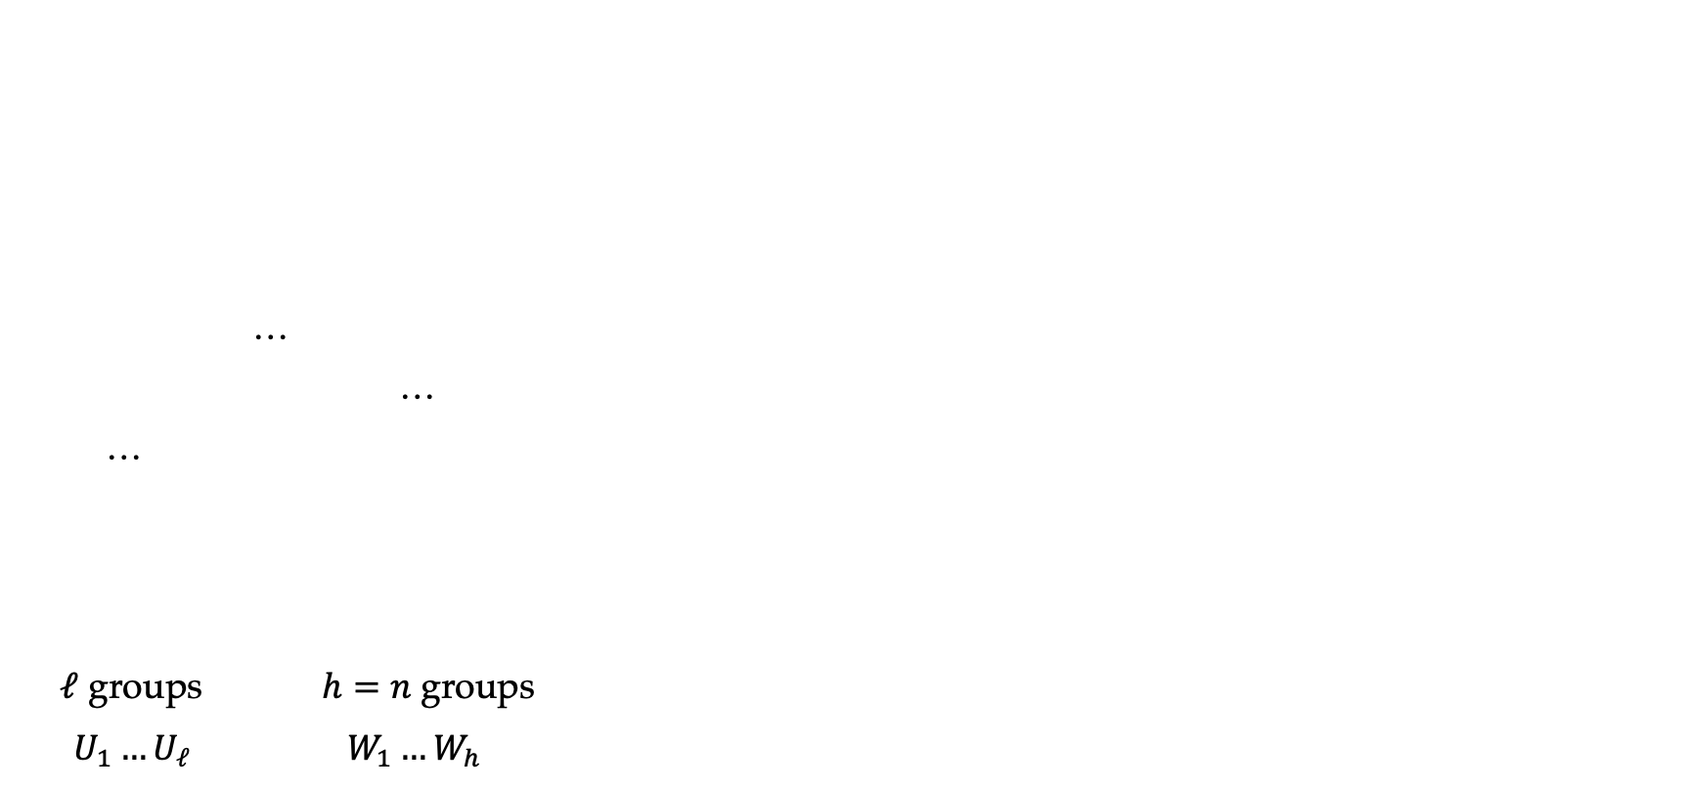
MaxCover & MinLabel: Compressing Left Groups
$(m,ℓ,k,r,ε)$-Disperser
a collection of $ℓ$ subsets $I_{1},…,I_{ℓ}$ of $[m]$, each of size $k$
the union of any $r$ different sets has size $≥\left(1−ε\right)m$
can be constructed efficiently with $k=O(m/εr)$
Compress the left side into $ℓ$ groups according to the disperser
…
…
…
$ℓ$ groups $h=n$groups
$U_{1}…U_{ℓ}$ $W_{1}…W_{h}$

Slide 19
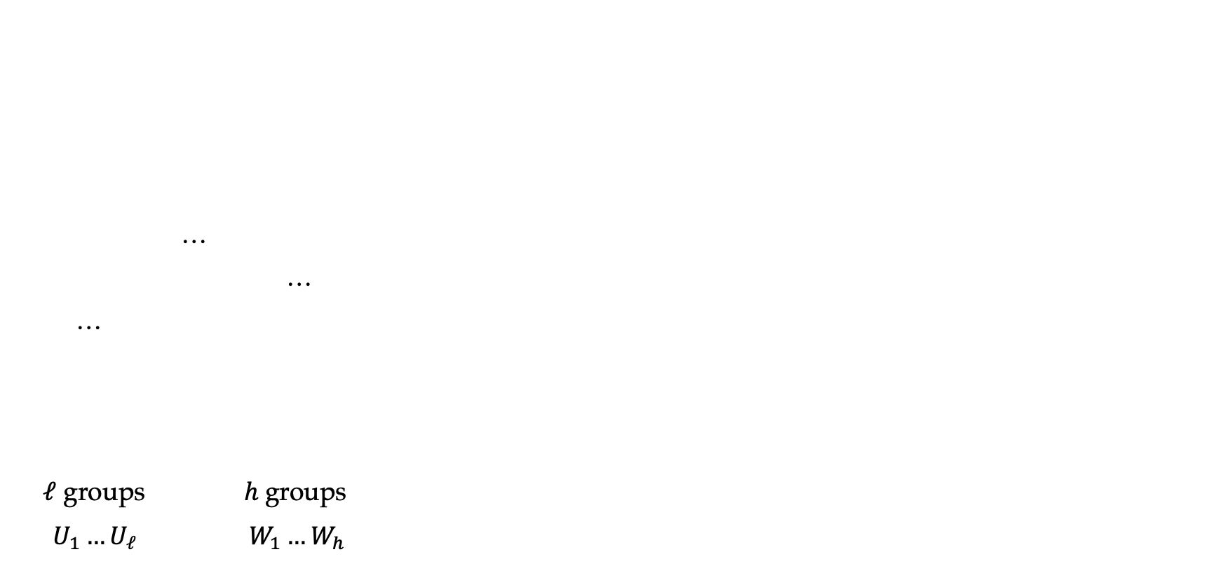
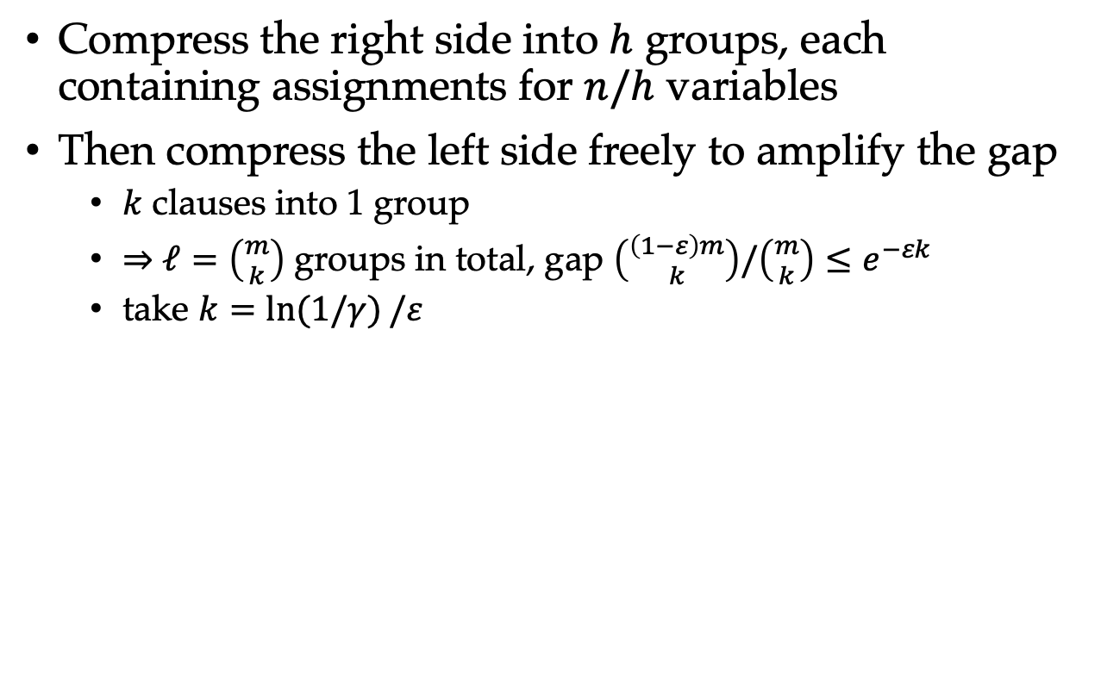
MaxCover & MinLabel: Compressing Right Groups
Compress the right side into $h$ groups, each containing assignments for $n/h$ variables
Then compress the left side freely to amplify the gap
$k$ clauses into 1 group
$⇒$ $ℓ=\left({m \atop k}\right)$ groups in total, gap $\left({\left(1−ε\right)m \atop k}\right)/\left({m \atop k}\right)≤e^{−εk}$
take $k=\ln{(1/γ)}/ε$
…
…
…
$ℓ$ groups $h$groups
$U_{1}…U_{ℓ}$ $W_{1}…W_{h}$

Slide 20
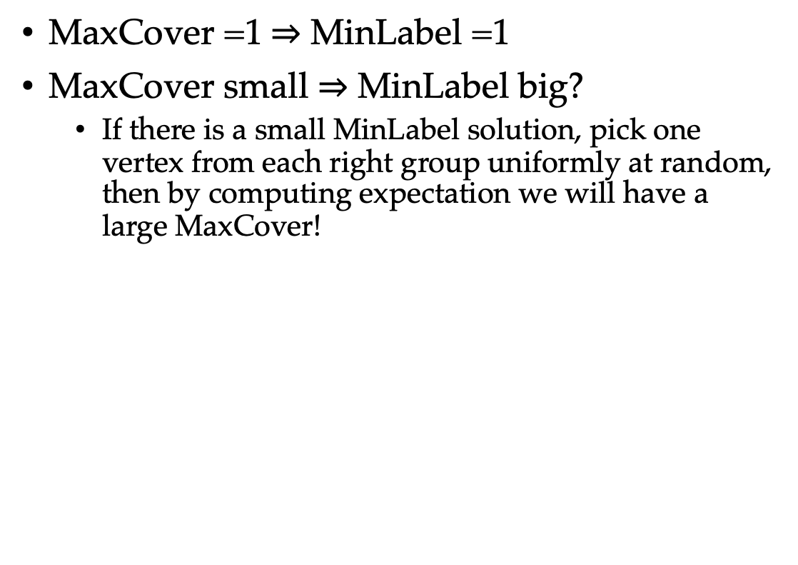
MaxCover to MinLabel
MaxCover =1$⇒$ MinLabel =1
MaxCover small $⇒$ MinLabel big?
If there is a small MinLabel solution, pick one vertex from each right group uniformly at random, then by computing expectation we will have a large MaxCover!
…
…
…
$ℓ$ groups $h$groups
$U_{1}…U_{ℓ}$ $W_{1}…W_{h}$

Slide 21
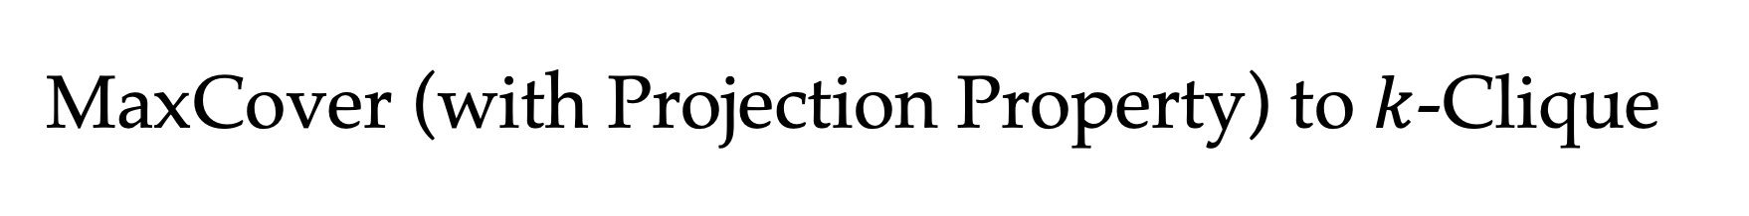
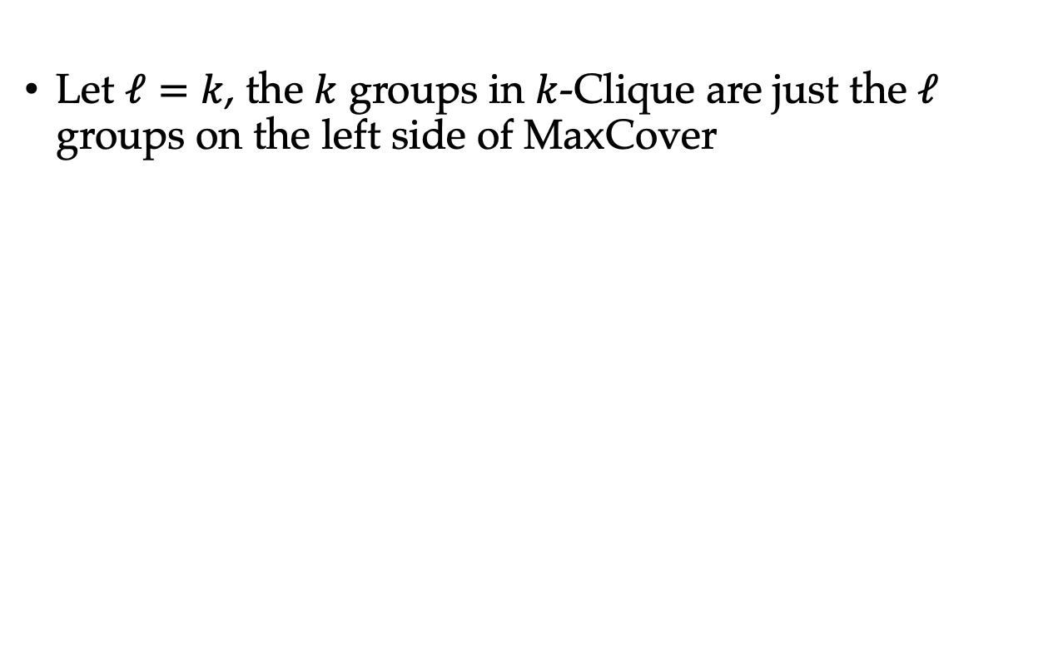
MaxCover (with Projection Property) to $k$-Clique
Let $ℓ=k$, the $k$ groups in $k$-Clique are just the $ℓ$ groups on the left side of MaxCover
…
…
…
$ℓ$ groups $h=n$groups
$U_{1}…U_{ℓ}$ $W_{1}…W_{h}$

Slide 22
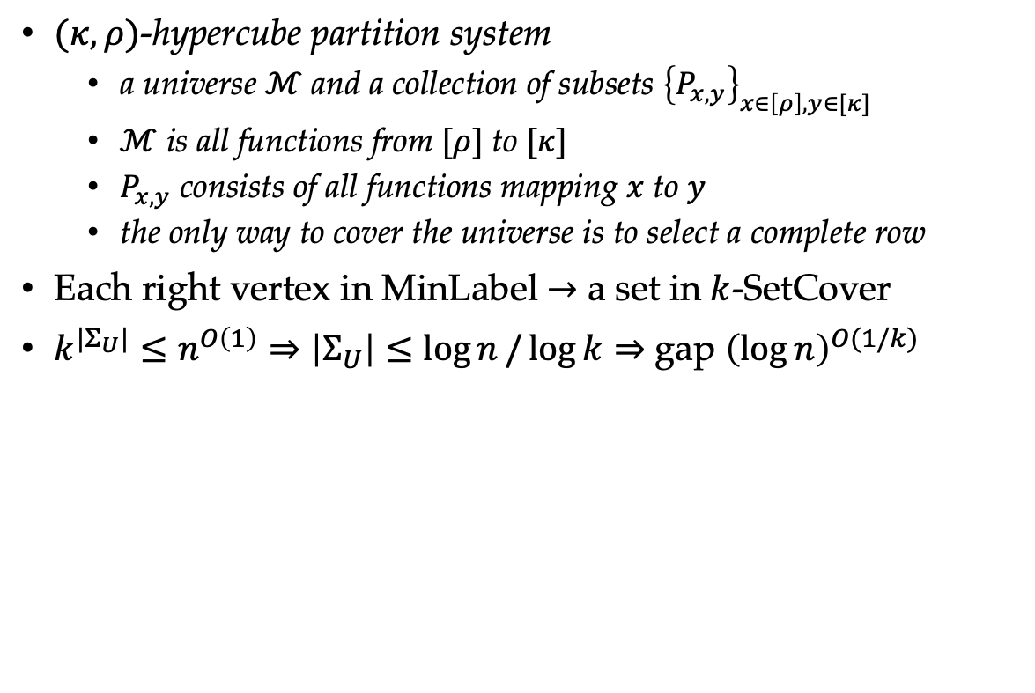
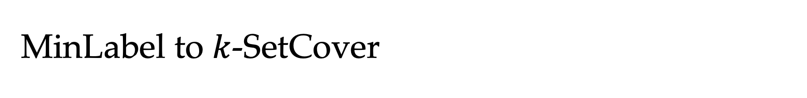
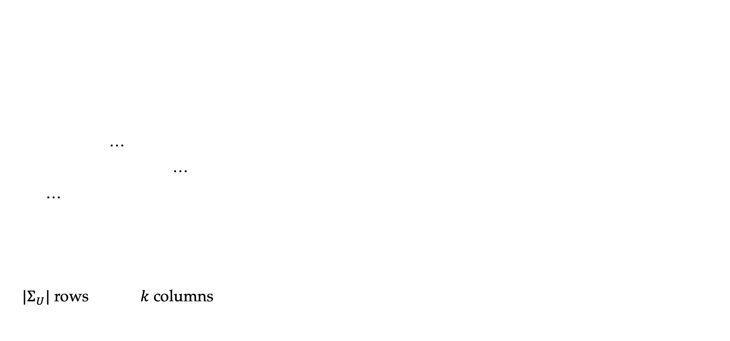
MinLabel to $k$-SetCover
$(κ,ρ)$-hypercube partition system
a universe $ℳ$ and a collection of subsets ${\left\{P_{x,y}\right\}}_{x∈\left[ρ\right],y∈[κ]}$
$ℳ$ is all functions from $[ρ]$ to $[κ]$
$P_{x,y}$ consists of all functions mapping $x$ to $y$
the only way to cover the universe is to select a complete row
Each right vertex in MinLabel $→$ a set in $k$-SetCover
$k^{|Σ_{U}|}≤n^{O\left(1\right)}⇒\left|Σ_{U}\right|≤\log{n}/\log{k}⇒$ gap ${\left(\log{n}\right)}^{O(1/k)}$
…
…
…
$|Σ_{U}|$ rows $k$ columns

Slide 23
Amplifying the Gap V.S. Creating a Gap
Gap-ETH: already provides a gap
ETH, W[1]≠FPT, …: ?

Slide 24
Amplifying the Gap V.S. Creating a Gap
Gap-ETH: already provides a gap
ETH, W[1]≠FPT, … ?

Slide 25
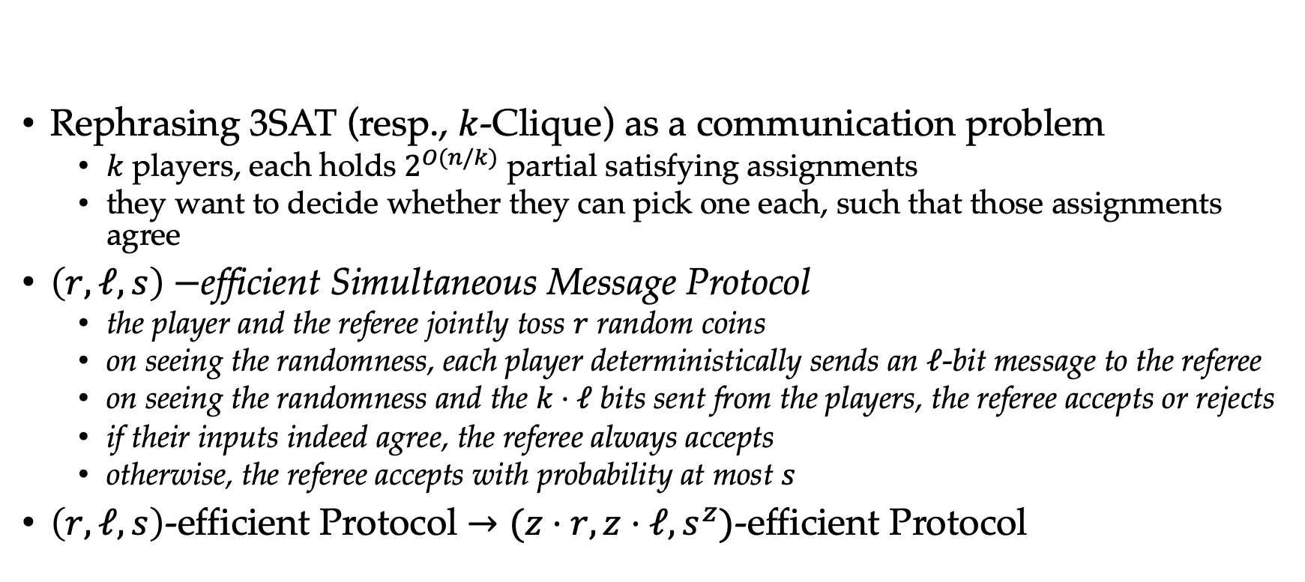
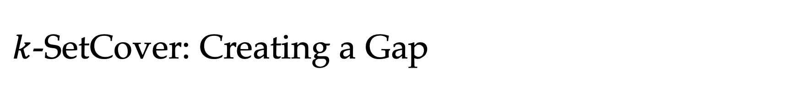
$k$-SetCover: Creating a Gap
Rephrasing 3SAT (resp., $k$-Clique) as a communication problem
$k$ players, each holds $2^{O(n/k)}$ partial satisfying assignments
they want to decide whether they can pick one each, such that those assignments agree
$\left(r,ℓ,s\right)−$efficient Simultaneous Message Protocol
the player and the referee jointly toss $r$ random coins
on seeing the randomness, each player deterministically sends an $ℓ$-bit message to the referee
on seeing the randomness and the $k⋅ℓ$ bits sent from the players, the referee accepts or rejects
if their inputs indeed agree, the referee always accepts
otherwise, the referee accepts with probability at most $s$
$\left(r,ℓ,s\right)$-efficient Protocol $→(z⋅r,z⋅ℓ, s^{z})$-efficient Protocol

Slide 26
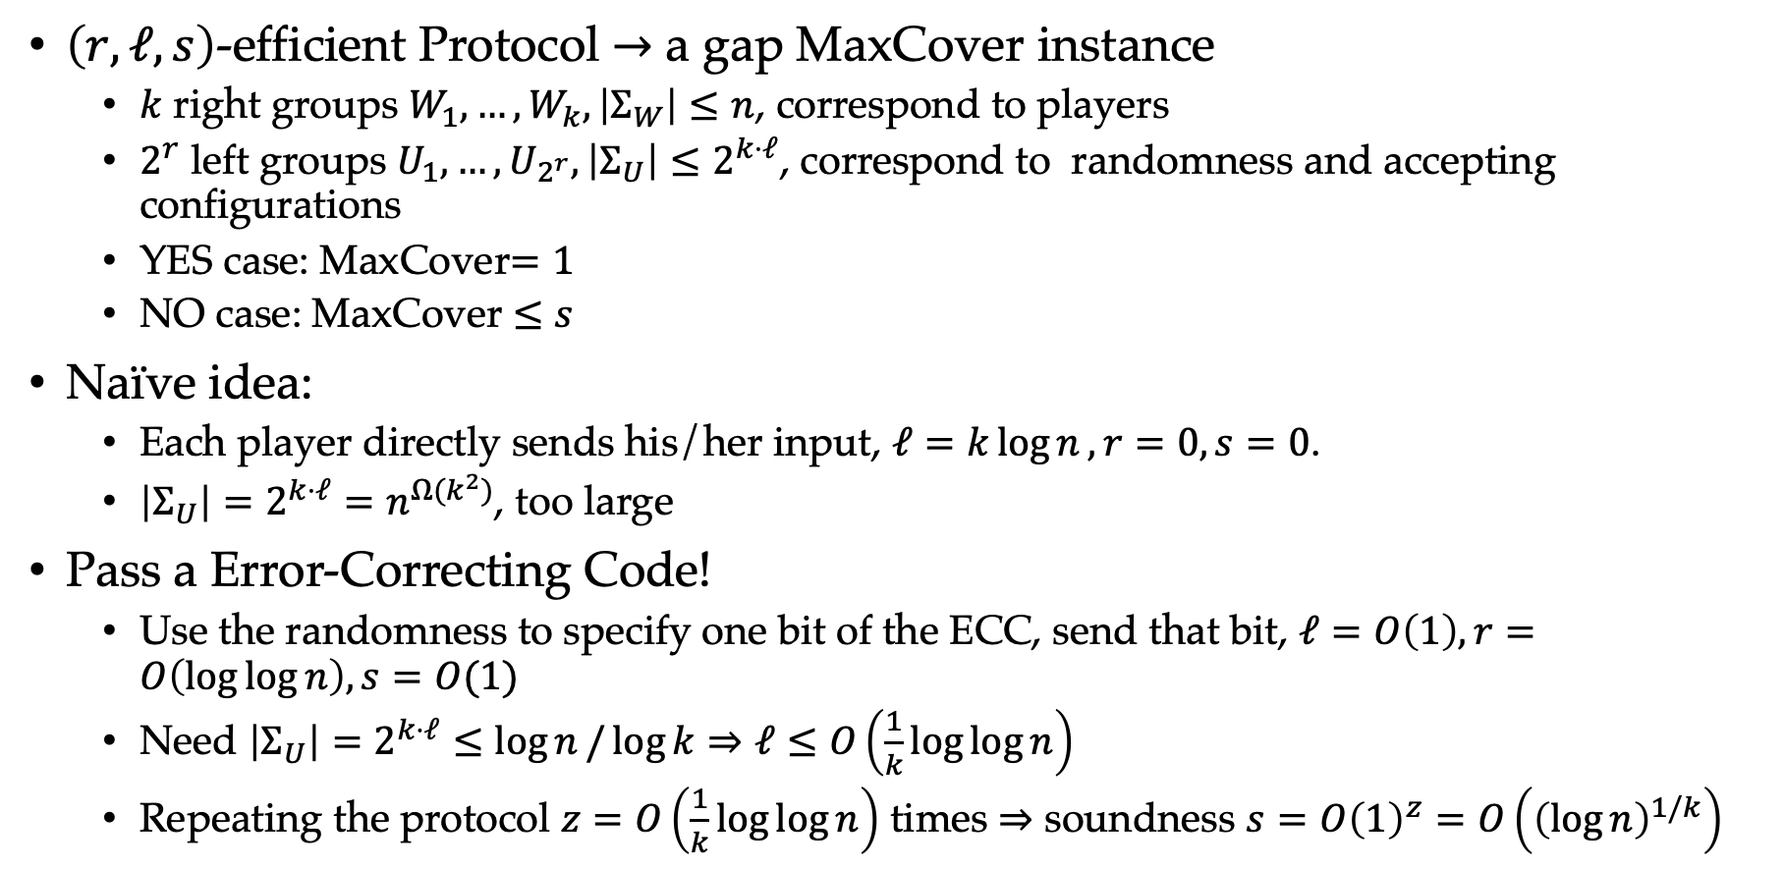
$k$-SetCover: Creating a Gap
$\left(r,ℓ,s\right)$-efficient Protocol $→$ a gap MaxCover instance
$k$ right groups $W_{1},…,W_{k}, \left|Σ_{W}\right|≤n$, correspond to players
$2^{r}$ left groups $U_{1},…,U_{2^{r}}, \left|Σ_{U}\right|≤2^{k⋅ℓ}$, correspond to randomness and accepting configurations
YES case: MaxCover$=1$
NO case: MaxCover $≤s$
Naïve idea:
Each player directly sends his/her input, $ℓ=k\log{n}, r=0,s=0$.
$\left|Σ_{U}\right|=2^{k⋅ℓ}=n^{Ω(k^{2})}$, too large
Pass a Error-Correcting Code!
Use the randomness to specify one bit of the ECC, send that bit, $ℓ=O\left(1\right), r=O\left(\log{\log{n}}\right),s=O(1)$
Need $\left|Σ_{U}\right|=2^{k⋅ℓ}≤\log{n}/\log{k}⇒ℓ≤O\left(\frac{1}{k}\log{\log{n}}\right)$
Repeating the protocol $z=O\left(\frac{1}{k}\log{\log{n}}\right)$ times $⇒$ soundness $s=O{\left(1\right)}^{z}=O\left({\left(\log{n}\right)}^{1/k}\right)$

Slide 27
More…
Creating a gap by
Threshold Graph Composition [Lin15, CL16, Lin19, BBE+19, KN21]
Distributed PCP Framework [KLM18]
Locally Decodable Codes [Lin21, LRSW21]
Still a lot to be explored …

Slide 28
Q & A
For more details, see my survey: https://arxiv.org/abs/2112.04669 or a more integral one: https://arxiv.org/abs/2006.04411
Contact:
E-Mail: renxuandi@pku.edu.cn
WeChat ID: xuandiren
Thanks!

